Slide 1

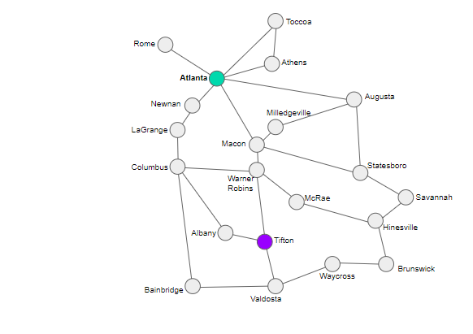
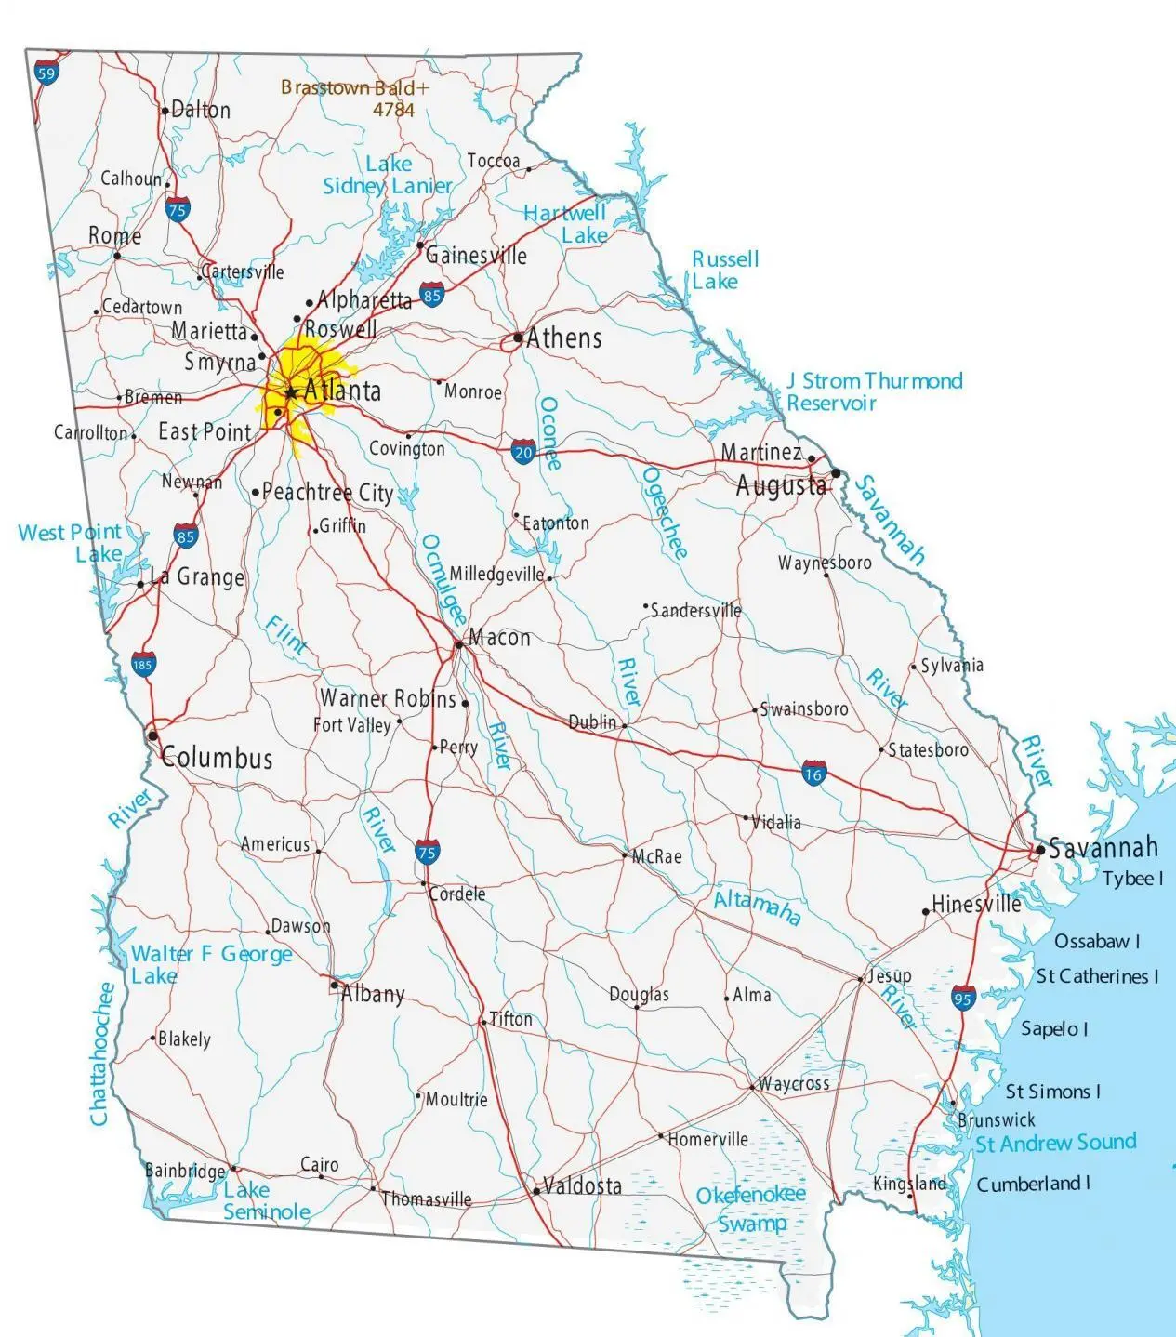

Module 1.5
Route Finding
Living and Working with Artificial Intelligence
Find a route from Atlanta to Tifton
Developed for the AI4GA (Artificial Intelligence for Georgia) project funded by National Science Foundation awards DRL-2049029 and DRL-2048502.
Additional funding was provided by a gift from Google. This work is licensed under the Creative Commons Attribution-NonCommercial-ShareAlike 4.0 International License. https://creativecommons.org/licenses/by-nc-sa/4.0/

Slide 2
Warm-up Questions

Slide 3
Warm-up Question
How do autonomous robots and self-driving cars find their way through the world?

Slide 4
Autonomous robots and self-driving cars make and use maps of their worlds

Slide 5
Personal Connection:
What kinds of maps have
you used in the past?
Notes:
Let the students provide some examples.
Then click through the next few slides and show them maps with different representations and of different locations

Slide 6
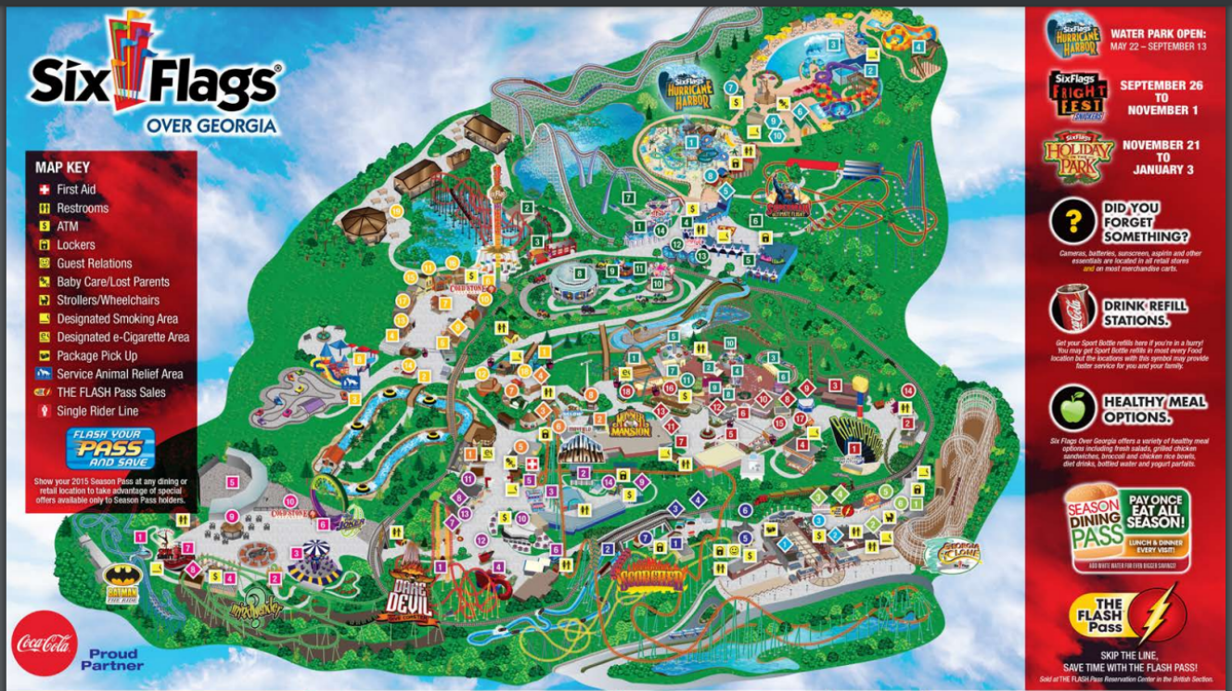
Notes:
Take Away - levels of representation
Here is a map of Six Flags over Georgia, What kinds of things have they chosen to represent and how?
This map tries to reflect the geographical features of the amusement park as well as key places a person might want to know about: Bathrooms, major rides, places to eat
Instead of adding names for each location, they label them with numbers.
They have also labeled major park areas using colors.
How would you give instructions to a person using this map?
Link to Source with key - https://www.sixflags.com/sites/default/files/sfog_fullmap.pdf

Slide 7
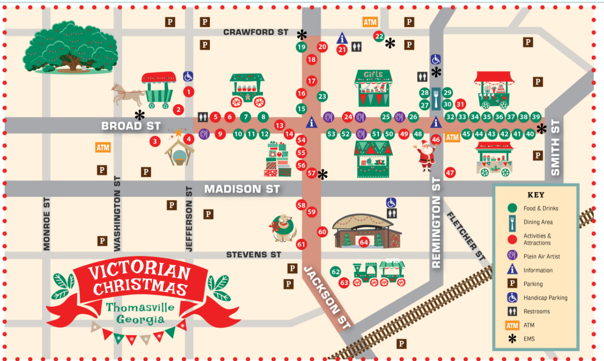
Notes:
Let’s look at another map, this one is of downtown Thomasville, GA.
Pre-pandemic, they help their annual Victorian Christmas festival.
What do you notice about this map? What key things did the map designer chose to represent?
Street names
Major festival activity path in brown
Major landmarks (big tree and railroad)
Key festival activities - nativity scene, christmas tree, train ride,
Key festival booths/stations
How would you give directions using this map?
Link to Source with key - https://thomasvillega.com/uploads/groups/3/Attractions/Festivals/Victorian%20Christmas/Small-Map-Final.jpg

Slide 8
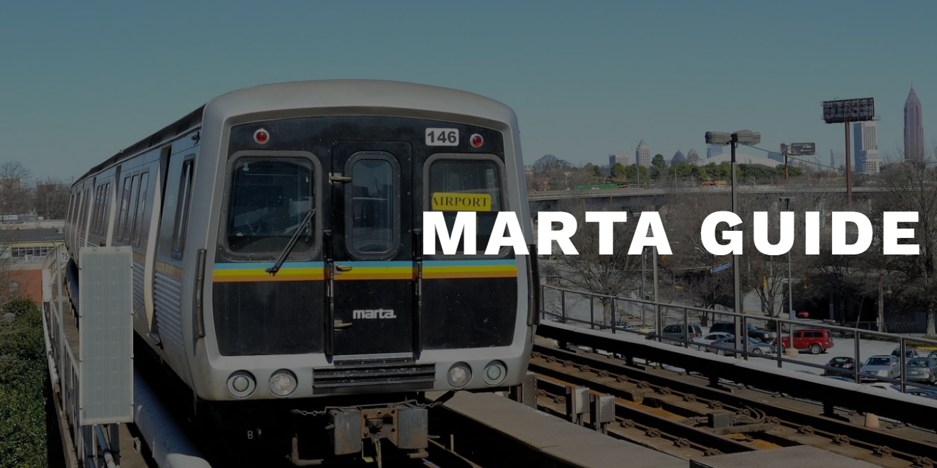
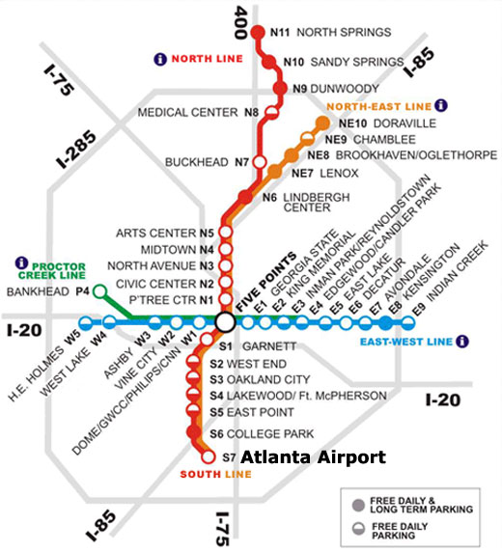
Notes:
This is a map of the Marta train in Atlanta.

Slide 9
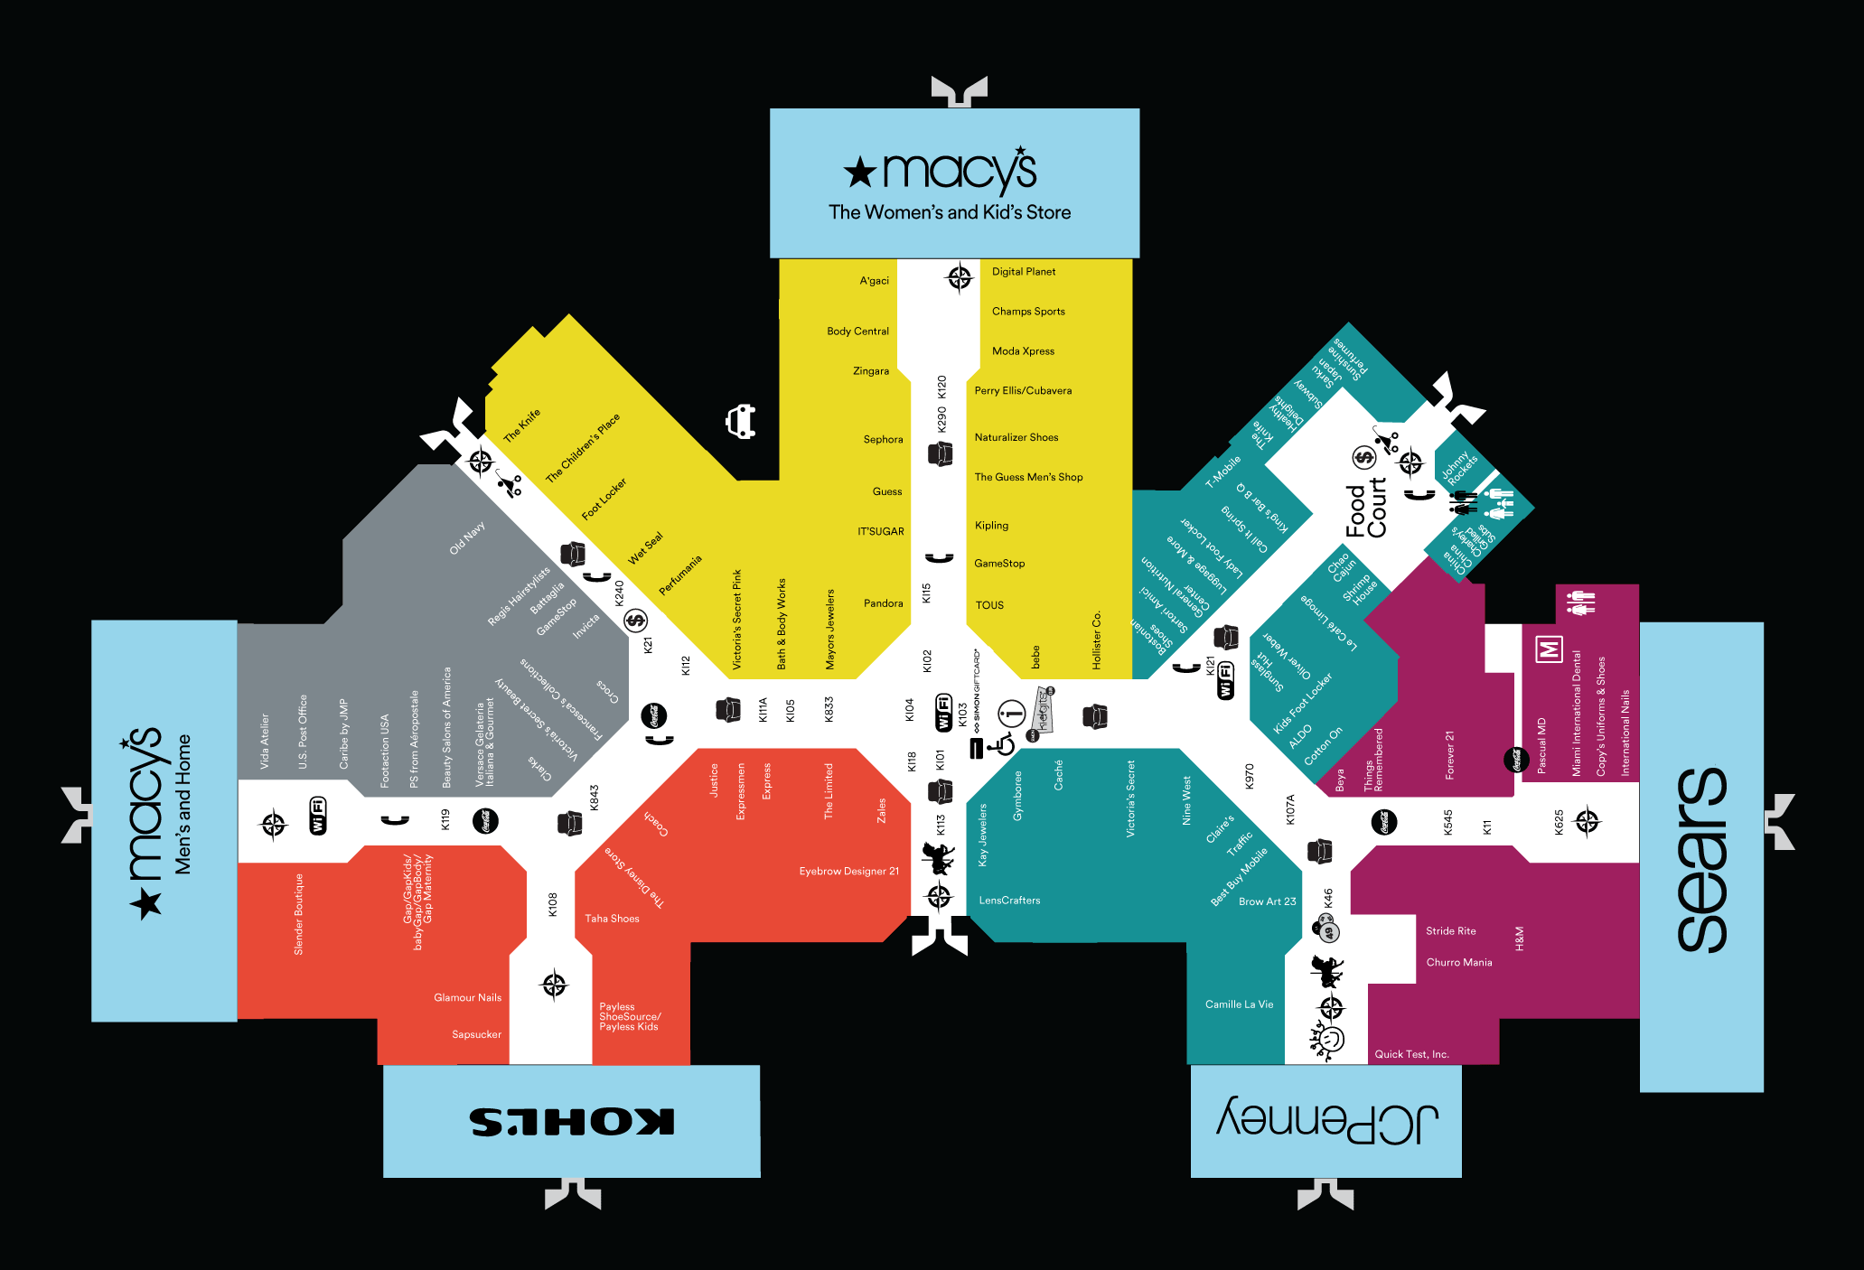
Finding paths through the mall

Slide 10
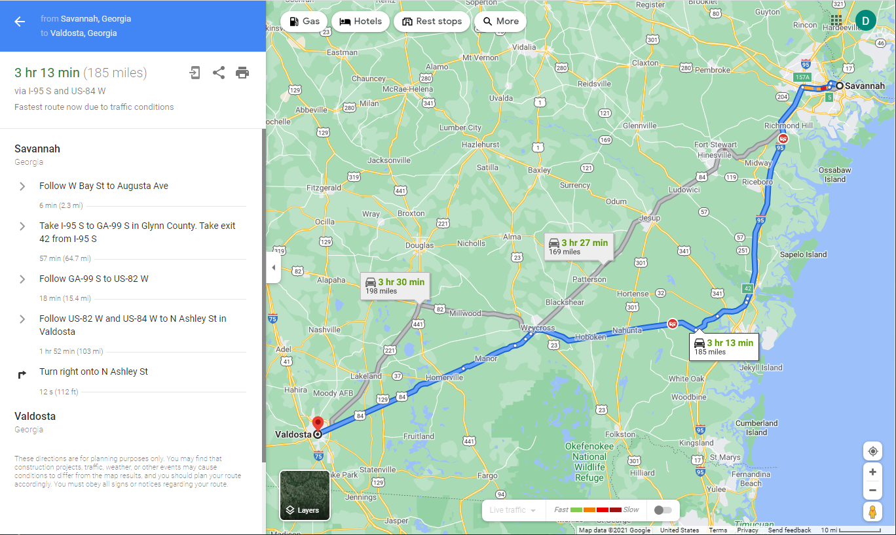
How does a self-driving car know which route to follow?
Map of Georgia
How does Google Maps create directions for you?

Slide 11
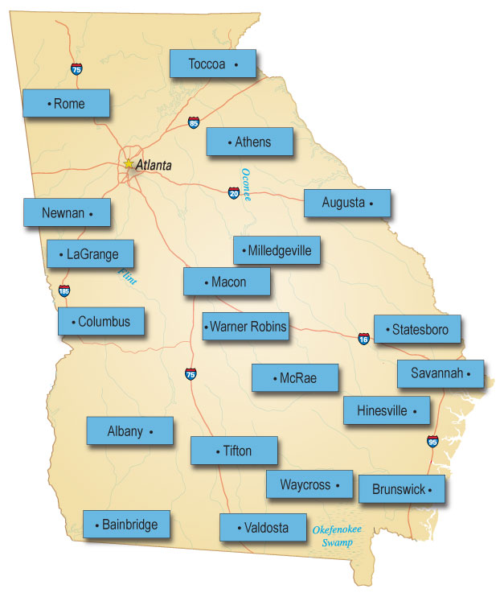
Let’s create a representation a computer could use.
It’s called a “graph”.
For each city, we’ll add a blue label and type the city name.
Label for each city
Notes:
Let’s identify some key cities in Georgia and label them on the map in blue.

Slide 12
For each city, we now need to add a node
Node - represents the location for each city
Notes:
Now, let’s add nodes representing the location of the selected cities, we’ll place the nodes next to their labels

Slide 13
Now, we need to represent the roads that connect the cities, we’ll use:
links - represent the roads connecting cities
Links connect nodes together
Notes:
Last, we need need to create links between these node (cities) represent roads that connect the cities.

Slide 14
Georgia cities graph
Toccoa
Route finding is
a graph search
problem.
Rome
Athens
Atlanta
Newnan
Augusta
Milledgeville
LaGrange
Macon
Columbus
Statesboro
Warner Robins
McRae
Savannah
Albany
Hinesville
Tifton
Waycross
Brunswick
Bainbridge
Valdosta
Notes:
Now we have our completed graph with nodes representing each city and their labels, and link representing the roads that connect them.

Slide 15
Breadth-First Search
Today we will learn an algorithm called the “breadth-first search”.
Breadth-First means at each level, we examine all the neighboring cities to the ones just reached, before proceeding to the next level. We keep going until we reach our destination.

Slide 16
Breadth-First Search (Using Colors)
Toccoa
Rome
Athens
Atlanta
Augusta
Color the starting city as level 0.
Find all the uncolored neighbors, and
color them using the next level’s color.
Repeat step 2 until you’ve colored
the destination city.
Newnan
Milledgeville
LaGrange
Macon
Columbus
Statesboro
Warner Robins
McRae
Savannah
Albany
Hinesville
Tifton
Waycross
Brunswick
Level 0
Level 1
Level 2
Level 3
Level 4
Bainbridge
Valdosta

Slide 17
How to get from Savannah to Valdosta: Level 0
Toccoa
Color our start city:
Savannah is level 0.
Rome
Athens
Level 0
Atlanta
Newnan
Augusta
Milledgeville
LaGrange
Macon
Columbus
Statesboro
Warner Robins
McRae
Savannah
Albany
Hinesville
Tifton
Waycross
Brunswick
Bainbridge
Valdosta
Which cities will be cities?
Level 1

Slide 18
How to get from Savannah to Valdosta: Level 1
Toccoa
Color the cities reachable from Savannah as level 1.
Rome
Athens
Level 0
Atlanta
Augusta
Level 1
Newnan
Milledgeville
LaGrange
Macon
Columbus
Statesboro
Warner Robins
McRae
Savannah
Albany
Hinesville
Tifton
Waycross
Brunswick
Bainbridge
Valdosta
Which cities will be cities?
Level 2

Slide 19
How to get from Savannah to Valdosta: Level 2
Toccoa
Color the uncolored neighbors of level 1 cities as level 2.
Rome
Athens
Level 0
Atlanta
Augusta
Level 1
Newnan
Milledgeville
LaGrange
Level 2
Macon
Columbus
Statesboro
Warner Robins
McRae
Savannah
Albany
Hinesville
Tifton
Waycross
Brunswick
Bainbridge
Valdosta
Which cities will be cities?
Level 3

Slide 20
How to get from Savannah to Valdosta: Level 3
Toccoa
Color the uncolored neighbors of level 2 cities as level 3.
Rome
Athens
Level 0
Atlanta
Augusta
Level 1
Newnan
Milledgeville
LaGrange
Level 2
Macon
Columbus
Statesboro
Level 3
Warner Robins
McRae
Savannah
Albany
Hinesville
Tifton
Waycross
Brunswick
Bainbridge
Valdosta
Which cities will be cities?
Level 4

Slide 21
How to get from Savannah to Valdosta: Level 4
Toccoa
Color the uncolored neighbors of level 3 cities as level 4.
This includes our destination city, Valdosta.
Yay!
Rome
Athens
Level 0
Atlanta
Augusta
Level 1
Newnan
Milledgeville
LaGrange
Level 2
Macon
Columbus
Statesboro
Level 3
Warner Robins
McRae
Savannah
Level 4
Albany
Hinesville
Tifton
Waycross
Brunswick
Bainbridge
Valdosta
There are still some cities left uncolored. Do we need to go to level 5?

Slide 22
How do you recover the solution path?
Toccoa
Start at the goal: Valdosta. It is at level 4. Write down the label of that node.
Find a neighbor one level below. Write down its label and move to that node.
Repeat step 2 until you reach the starting point (Savannah), at level 0.
Level 0
Athens
Level 0
Atlanta
Level 1
Augusta
Level 1
Milledgeville
Level 2
LaGrange
Level 2
Macon
Statesboro
Level 3
Columbus
Level 3
Warner Robins
McRae
Savannah
Level 4
Level 4
Albany
Hinesville
Tifton
Waycross
Brunswick
Bainbridge
Valdosta

Slide 23
Recovering the Solution Path
Toccoa
Draw a red line that follows the recovery path from your destination to the start node.
When you reverse the result, you will have the solution path.
Rome
Level 0
Athens
Level 0
Atlanta
Level 1
Augusta
Level 1
Newnan
Milledgeville
Level 2
LaGrange
Level 2
Macon
Statesboro
Level 3
Columbus
Level 3
Warner Robins
McRae
Savannah
Level 4
Level 4
Albany
Hinesville
Tifton
Waycross
Brunswick
Bainbridge
Valdosta

Slide 24

ACTIVITY TIME

Slide 25
Worksheet Page 1: Columbus to Brunswick
Toccoa
Work with your partner.
Color the starting city as level 0.
Find all the uncolored neighbors, and color them using the next level’s color.
Repeat step 2 until you’ve colored the destination city.
Pro-tip: Place your finger on first city. Trace the lines that leave the city. Those are the neighbors. This helps you not to miss any cities.
Rome
Athens
Level 0
Atlanta
Augusta
Level 1
Newnan
Milledgeville
LaGrange
Level 2
Macon
Columbus
Statesboro
Level 3
Warner Robins
McRae
Savannah
Level 4
Albany
Hinesville
Tifton
Waycross
Brunswick
Bainbridge
Valdosta
Notes:
You can print the worksheet in color. If you print in black and white, have students color the levels the same colors as they appear on the slides. Do this before beginning the worksheet.

Slide 26
Exercise: Columbus to Brunswick
Toccoa
Once you have finished coloring the nodes, you can trace backwards from the destination. Recover the solution!
Pro-tip: Be sure you do NOT repeat any colors when you trace for a solution.
Rome
Athens
Level 0
Atlanta
Augusta
Level 1
Newnan
Milledgeville
LaGrange
Level 2
Macon
Columbus
Statesboro
Level 3
Warner Robins
McRae
Savannah
Level 4
Albany
Hinesville
Tifton
Waycross
Brunswick
Bainbridge
Valdosta

Slide 27
Solutions: Columbus to Brunswick
Toccoa
There are two solutions.
The choice is arbitrary.
Rome
Athens
Level 0
Atlanta
Augusta
Level 1
Newnan
Milledgeville
LaGrange
Level 2
Macon
Columbus
Statesboro
Level 3
Warner Robins
McRae
Savannah
Level 4
Albany
Hinesville
Tifton
Waycross
Brunswick
Bainbridge
Valdosta

Slide 28
So let’s break down the Breadth-First Search Algorithm into steps
AI4K12 Guideline 2-B-ii
Make the starting city the root of the search tree (level 0).
For every node at the current level:
  Find its neighbors that are not already in the tree.
  Add those neighbors to the next level of the tree.
  If one of the neighbors is the destination, exit.
Repeat step 2 for the next level of the tree.

Slide 29
Reflection:
Describe how to conduct a breadth-first search
Notes:
Let the students provide some examples.
Then click through the next few slides and show them maps with different representations and of different locations

Slide 30
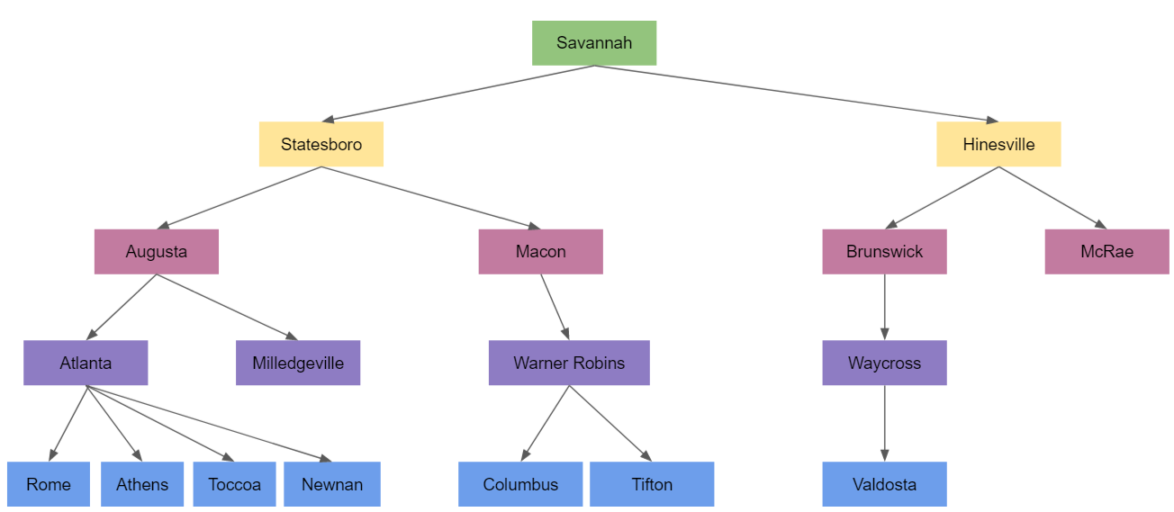
Breadth-First Search: Search Tree
Fun Fact: Breadth-first search can be used even when we don’t have a graph to color.
The algorithms works by constructing a search tree.

Slide 31
Let’s draw a search tree to find a route from Savannah to Valdosta
Toccoa
Let’s locate on the map
Savannah
Valdosta
Rome
Athens
Atlanta
Newnan
Augusta
Milledgeville
LaGrange
Macon
Columbus
Statesboro
Warner Robins
McRae
Savannah
Albany
Hinesville
Tifton
Waycross
Brunswick
Bainbridge
Valdosta
Notes:
Some interesting things to note about the “Atlanta to Warner Robins” problem. Atlanta has roads going off in all directions, so it emphasizes the fact that the algorithm has no idea which way to proceed; it has to try all possible paths. Also note that both Athens and Toccoa are directly reachable from Atlanta, so they will end up with the same color; the fact that there is a road from Athens to Toccoa doesn’t matter because Toccoa has already been colored by the time we start looking at Athens’ neighbors.

Slide 32
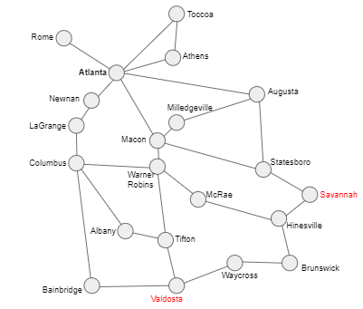
Breadth-First Search: Savannah to Valdosta
Step 1:
Make the starting city the root of the search tree (level 0).
Tree Root
Savannah

Slide 33
Breadth-First Search: Savannah to Valdosta
Current level
Step 2: For every node at the current level:
  Find its neighbors that are not already in the tree.
  Add those neighbors to the next level of the tree.
  If one of the neighbors is the destination, exit.
What cities neighbor Savannah?
Savannah

Slide 34
Breadth-First Search: Savannah to Valdosta
Current level
Savannah
Statesboro
Hinesville
Step 2: For every node at the current level:
  Find its neighbors that are not already in the tree.
  Add those neighbors to the next level of the tree.
  If one of the neighbors is the destination, exit.
Are we at our destination?

Slide 35
Breadth-First Search: Savannah to Valdosta
Savannah
Statesboro
Hinesville
Step 3: For every node at the current level:
  Find its neighbors that are not already in the tree.
  Add those neighbors to the next level of the tree.
  If one of the neighbors is the destination, exit.

Slide 36
Breadth-First Search: Savannah to Valdosta
Savannah
Statesboro
Hinesville
Augusta
Macon
Brunswick
McRae
What should we do next?
(Repeat the process again.)
Are we at our destination?

Slide 37
Breadth-First Search: Savannah to Valdosta
Savannah
Statesboro
Hinesville
Augusta
Macon
Brunswick
McRae
Atlanta
Milledgeville
Warner Robins
Waycross
Are we at our destination?

Slide 38
Breadth-First Search: Savannah to Valdosta
Savannah
Statesboro
Hinesville
Augusta
Macon
Brunswick
McRae
Atlanta
Milledgeville
Warner Robins
Waycross
Rome
Athens
Toccoa
Newnan
Columbus
Tifton
Valdosta
Are we at our destination?

Slide 39
Recovering the Solution Path
Draw a red line that follows the recovery path from your destination to the start node.
Savannah
Statesboro
Hinesville
Augusta
Macon
Brunswick
McRae
Atlanta
Milledgeville
Warner Robins
Waycross
Rome
Athens
Toccoa
Newnan
Columbus
Tifton
Valdosta

Slide 40
Before you try this on your own, let’s analyze some student work from last school year!
For each of the following slides (with a partner):
Identify any mistakes you can find on each student work sample map and tree.
What misconception do you believe caused the student to make that mistake? (What do you think that the student does not understand that caused them to make the mistake you found?)
Be prepared to discuss your findings.
Stephen and Nichole
6/24/24

Slide 41
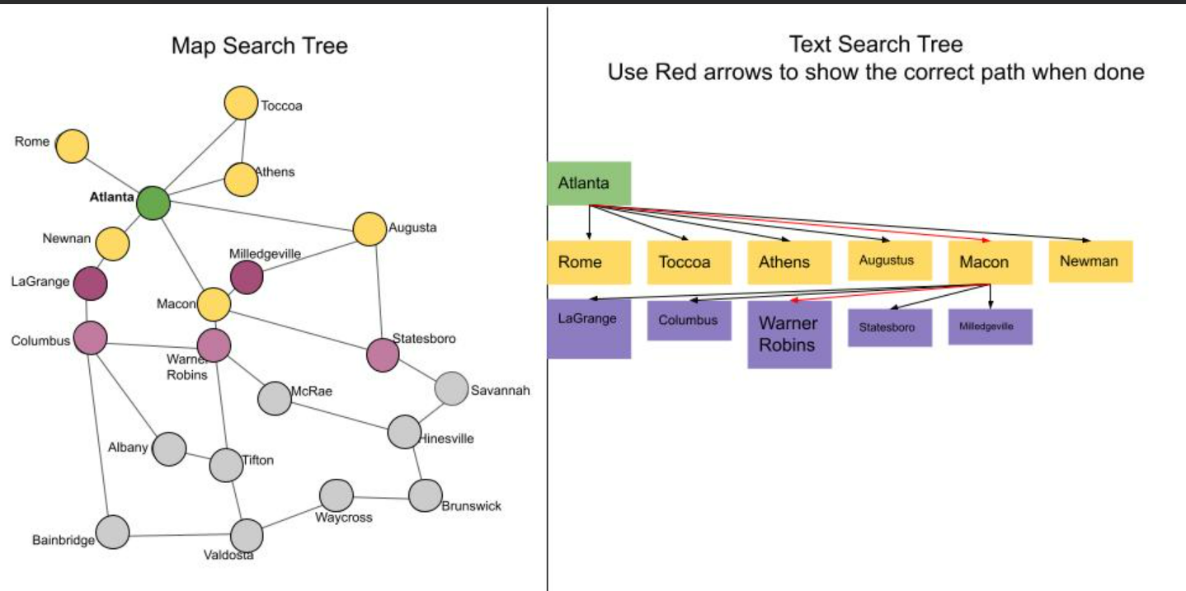
Find a route from Atlanta to Warner Robins
AW-0014

Slide 42
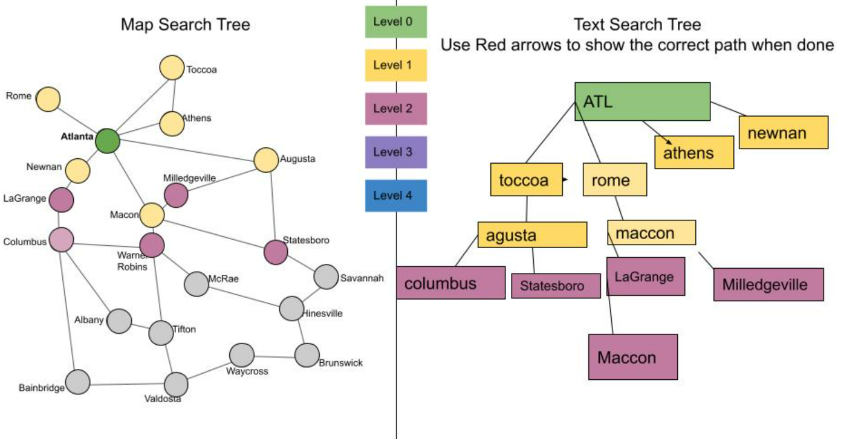
Find a route from Atlanta to Warner Robins
AW-0003

Slide 43
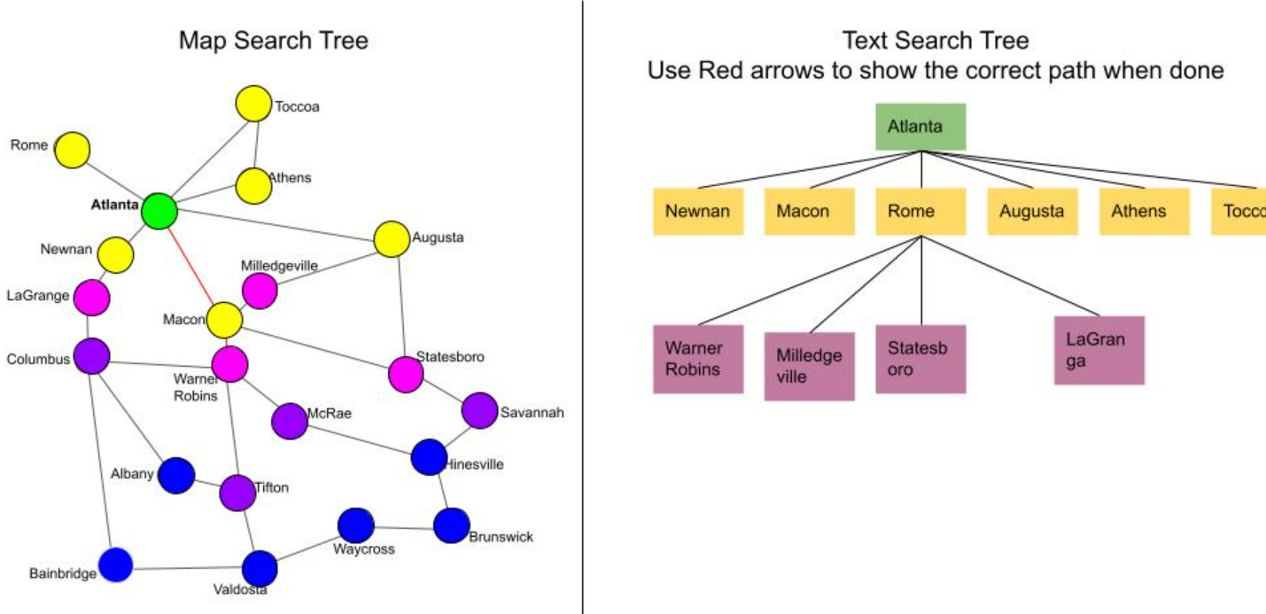
Find a route from Atlanta to Warner Robins
AW-0009

Slide 44
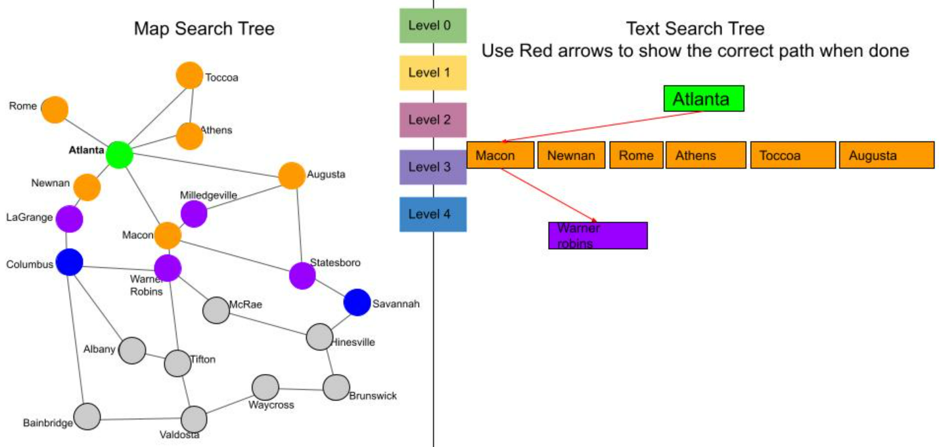
Find a route from Atlanta to Warner Robins
AW-0012

Slide 45
You try it:
Draw the search tree
Toccoa
Find a route from
Atlanta to
Warner Robins
Rome
Athens
Level 0
Atlanta
Augusta
Level 1
Newnan
Milledgeville
LaGrange
Level 2
Macon
Columbus
Statesboro
Level 3
Warner Robins
McRae
Savannah
Level 4
Albany
Hinesville
Tifton
Waycross
Brunswick
Bainbridge
Valdosta
Notes:
Some interesting things to note about the “Atlanta to Warner Robins” problem. Atlanta has roads going off in all directions, so it emphasizes the fact that the algorithm has no idea which way to proceed; it has to try all possible paths. Also note that both Athens and Toccoa are directly reachable from Atlanta, so they will end up with the same color; the fact that there is a road from Athens to Toccoa doesn’t matter because Toccoa has already been colored by the time we start looking at Athens’ neighbors.

Slide 46
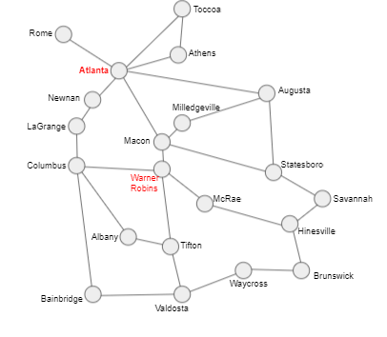
Breadth-First Search: Atlanta to Warner Robins
Recovering the Solution Path
Atlanta
Athens
Toccoa
Rome
Agusta
Newnan
Macon
Milledegeville
Statesboro
Legrange
Warner Robins
Route/Path
Atlanta
Macon
Warner Robins

Slide 47
Recap
TPS - summarize what you learned today

Slide 48
Recap
So far we’ve talked about maps and their representations, and an algorithm
that a self-driving car might use to navigate from one location to another.
We used labels, nodes, and links to create a graph of the state. Then used the breadth first search method to find a route from a starting location to a destination.

Slide 49
Other than a map for driving around a state, can you think of other kinds of maps a self-driving car or autonomous robot might create for themselves?

Slide 50
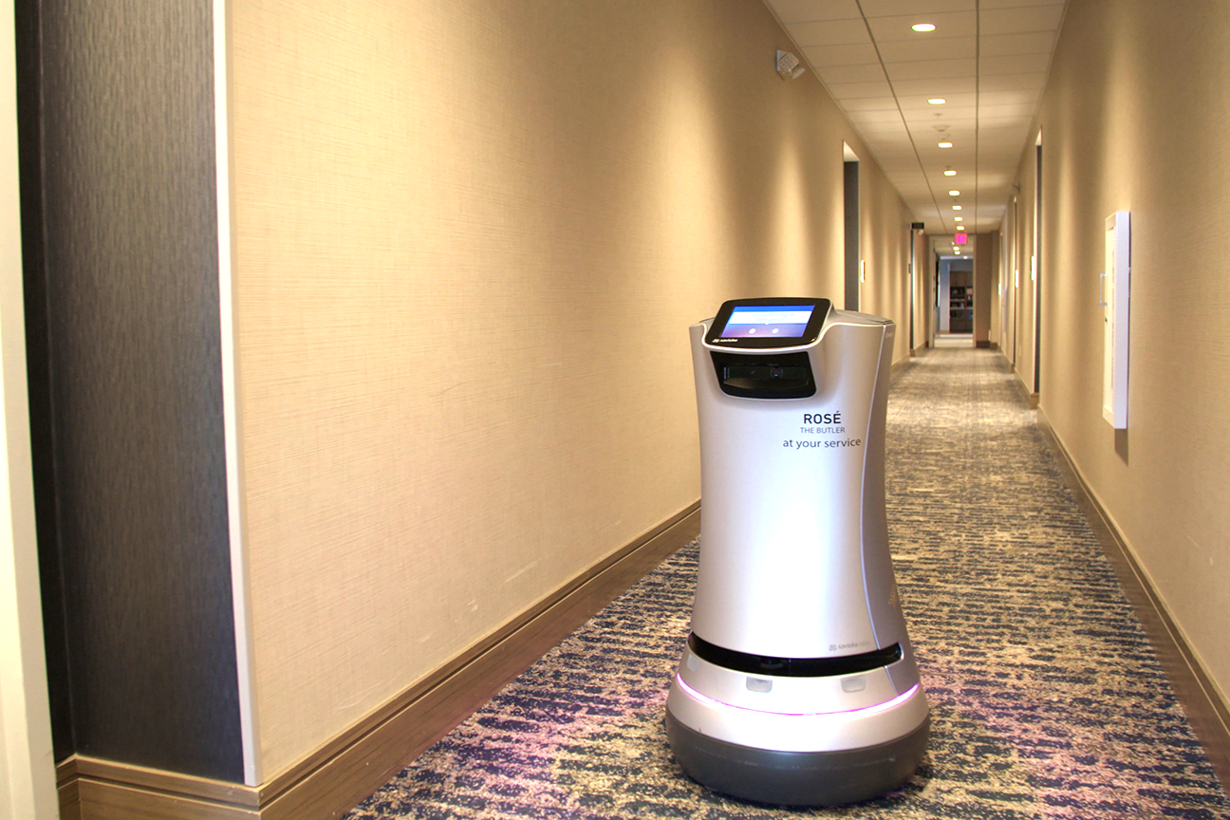

Other Applications for Route Finding
Autonomous robots might be given a map of a hotel, hospital, or warehouse.
Robot vacuum cleaners create a map of the home and you can use an app to see the map and adjust it.

Slide 51

Assessment:
Help Bloopaloop Junior Travel from Hinesville to Atlanta
Toccoa
Let’s locate on the map
Hinesville to Atlanta
Rome
Atlanta
Athens
Newnan
Augusta
Milledgeville
LaGrange
Macon
Columbus
Statesboro
Warner Robins
McRae
Savannah
Albany
Hinesville
Tifton
Waycross
Brunswick
Bainbridge
Valdosta

Slide 52

iDoggo and Route Finding
Apple has come back to you for more of your expertise!
They need you to add route finding to iDoggo so that he can navigate the house.
Apple has sent an example of a home to travel. Can you use a tree or breadth-first search to route from the “front door” to “my bedroom”?
Created by Midjourney prompt “Ddoggo a robot dog home companion made by Apple Computer”

Slide 53
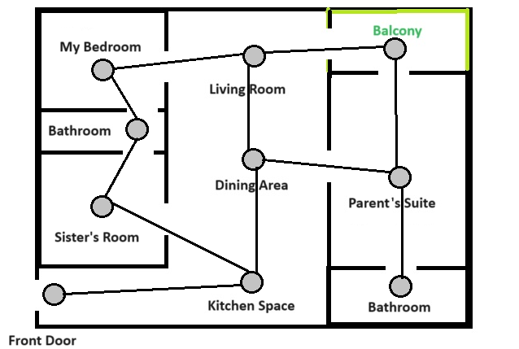

Route Finding from Front Door to My Bedroom
iDoggo needs route finding capabilities to walk around the house and find the best routes between rooms.

Slide 54
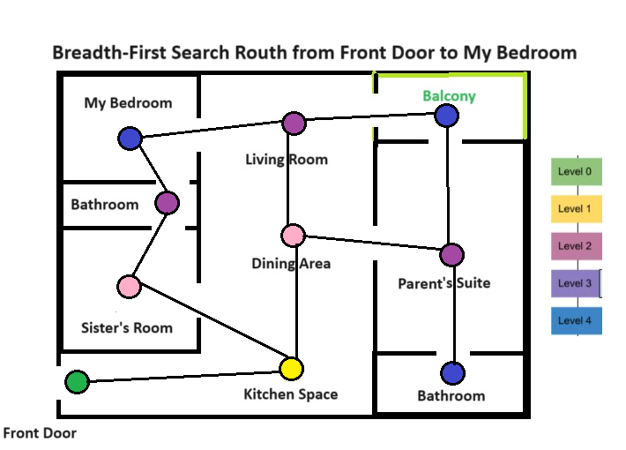
Route Finding

Slide 55
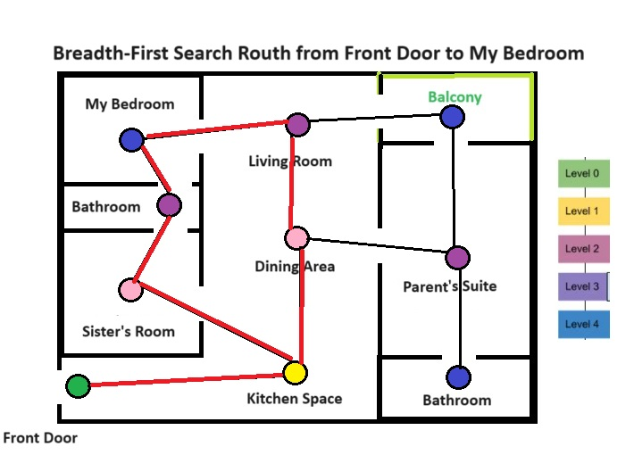
Route Finding
There are 2 possible routes.
Front Door, Kitchen, Sister’s Room, Bathroom, then My Bedroom.
OR
Front Door, Kitchen, Dining Area, Living Room, then My Bedroom.

